Slide 1
How to Make a Yeast Starter
October 7, 2020

Slide 2
What Is A Yeast Starter?
A yeast starter is simply a volume of wort that’s used for the sole purpose of growing yeast cells.

Slide 3
Why Make a Yeast Starter?
Brewing the best beer possible means using enough yeast to get the job done. Unfortunately a single vial/packages may not have enough yeast cells. A properly made starter lets you build up the # of yeast cells you need from just one yeast package.
You have an old package of liquid yeast in your fridge
You have saved yeast from a previous brew day
You are brewing a high ABV beer
You are brewing larger than 5 gallon batches

Slide 4
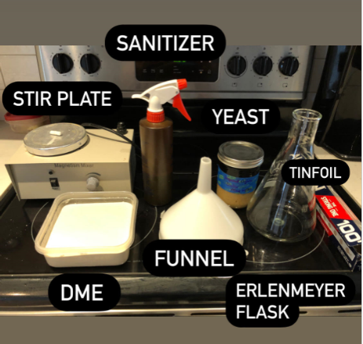
What Is Required?

Slide 5
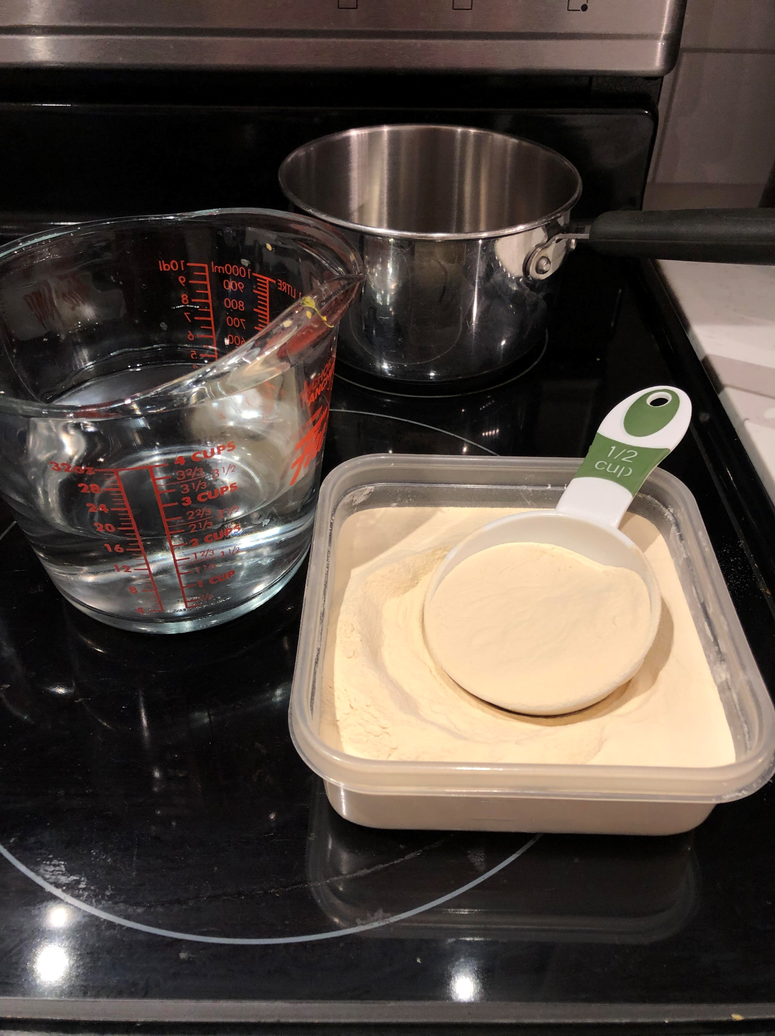
Yeast Starter – Step 1
Ratio of ½ Cup DME to 2 Cups Water

Slide 6
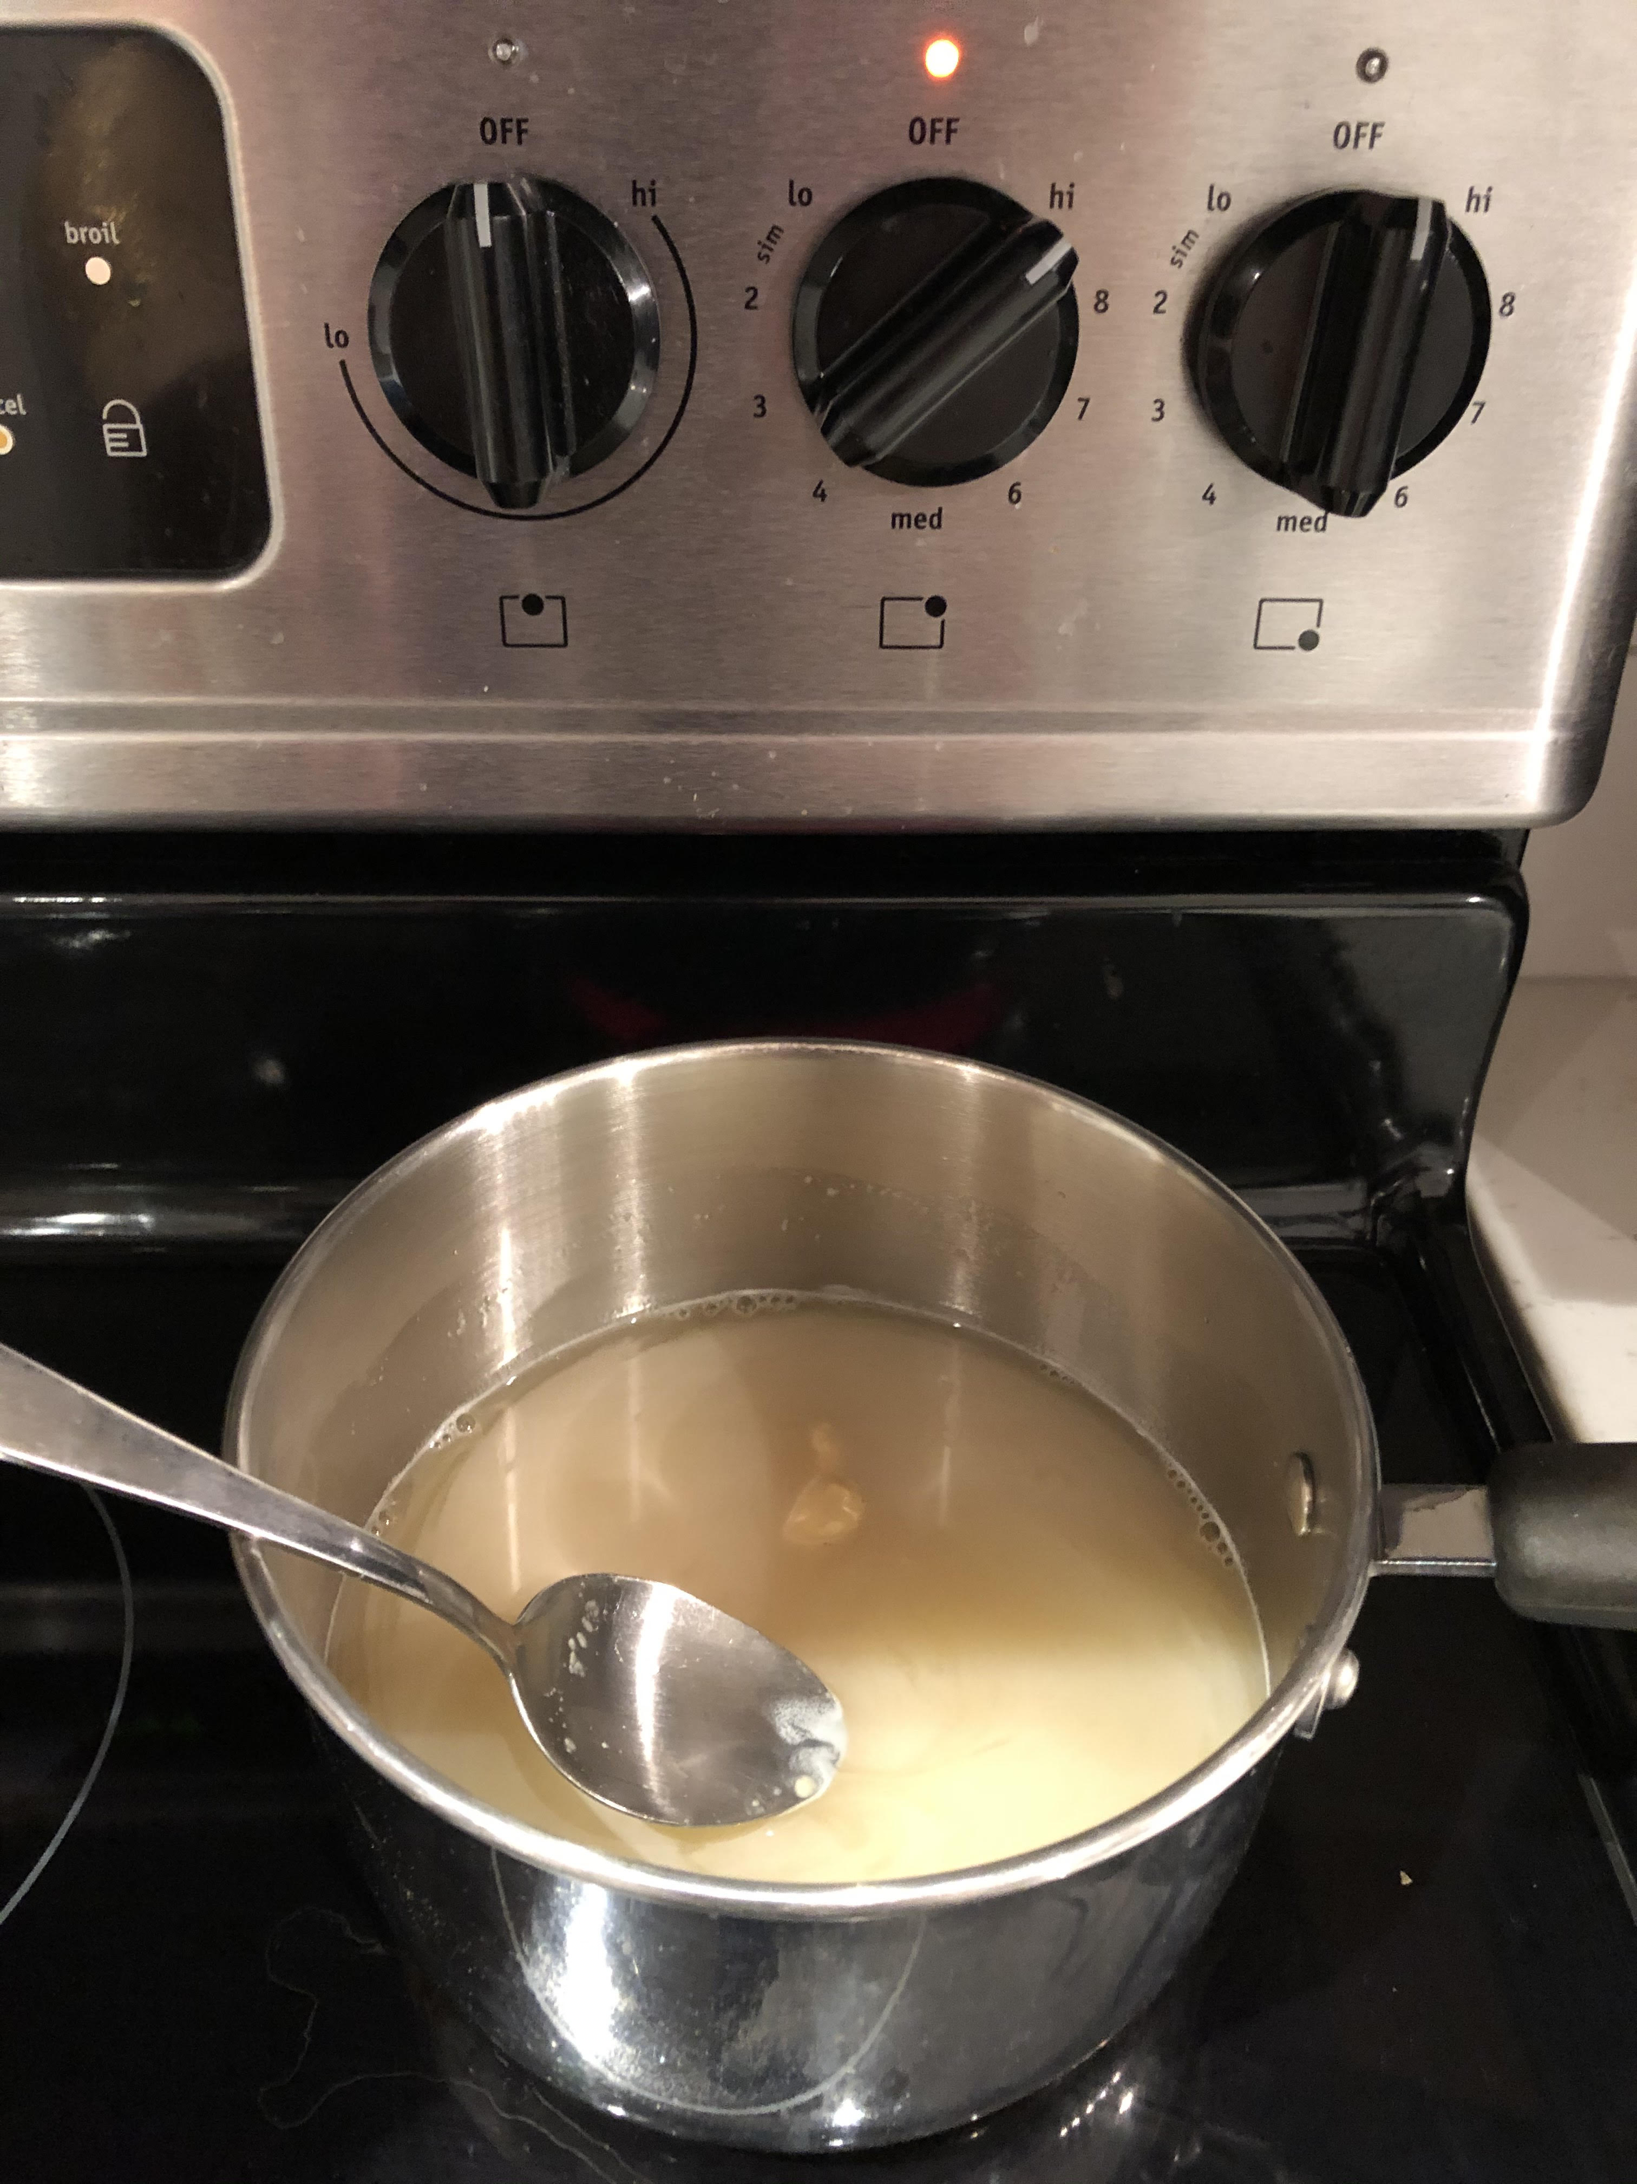
Yeast Starter – Step 2
Turn heat to high
Add water and DME in prior to boil and mix with a spoon

Slide 7
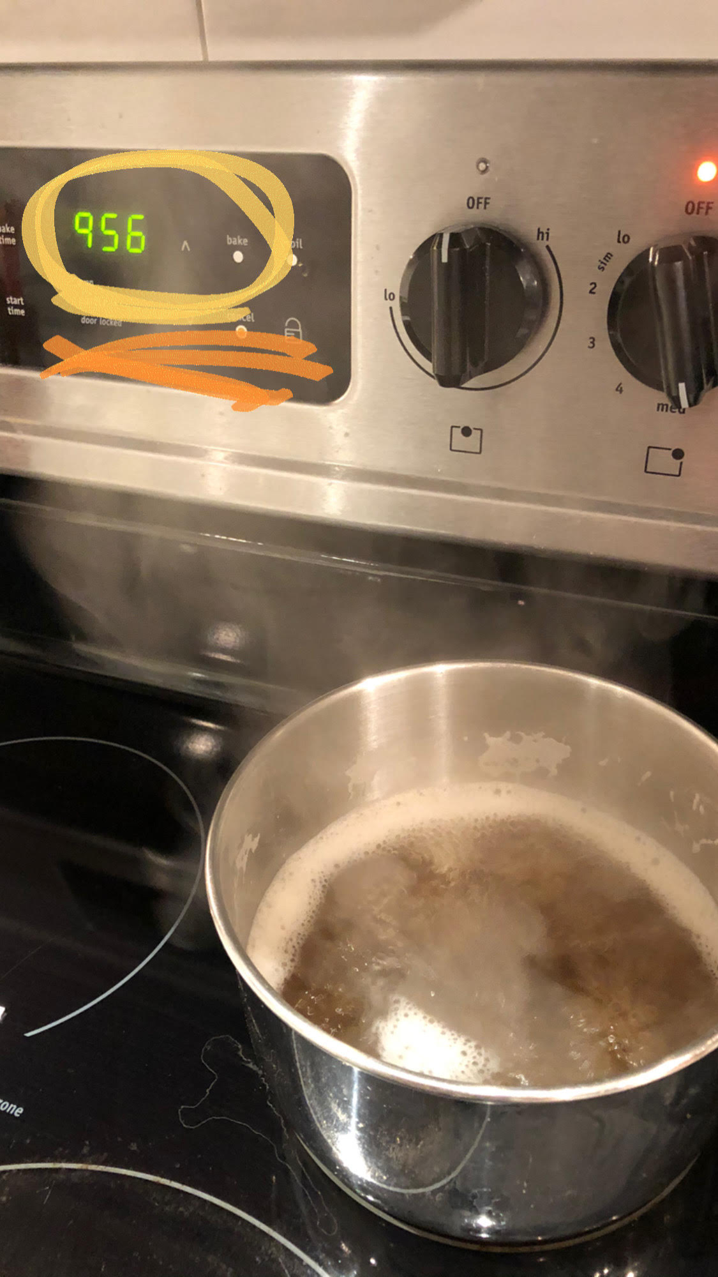
Yeast Starter – Step 3
Set timer to 10 minutes
Once it’s up to boil, start time and lower the heat to maintain boil
Ensure all DME is mixed into a solution

Slide 8
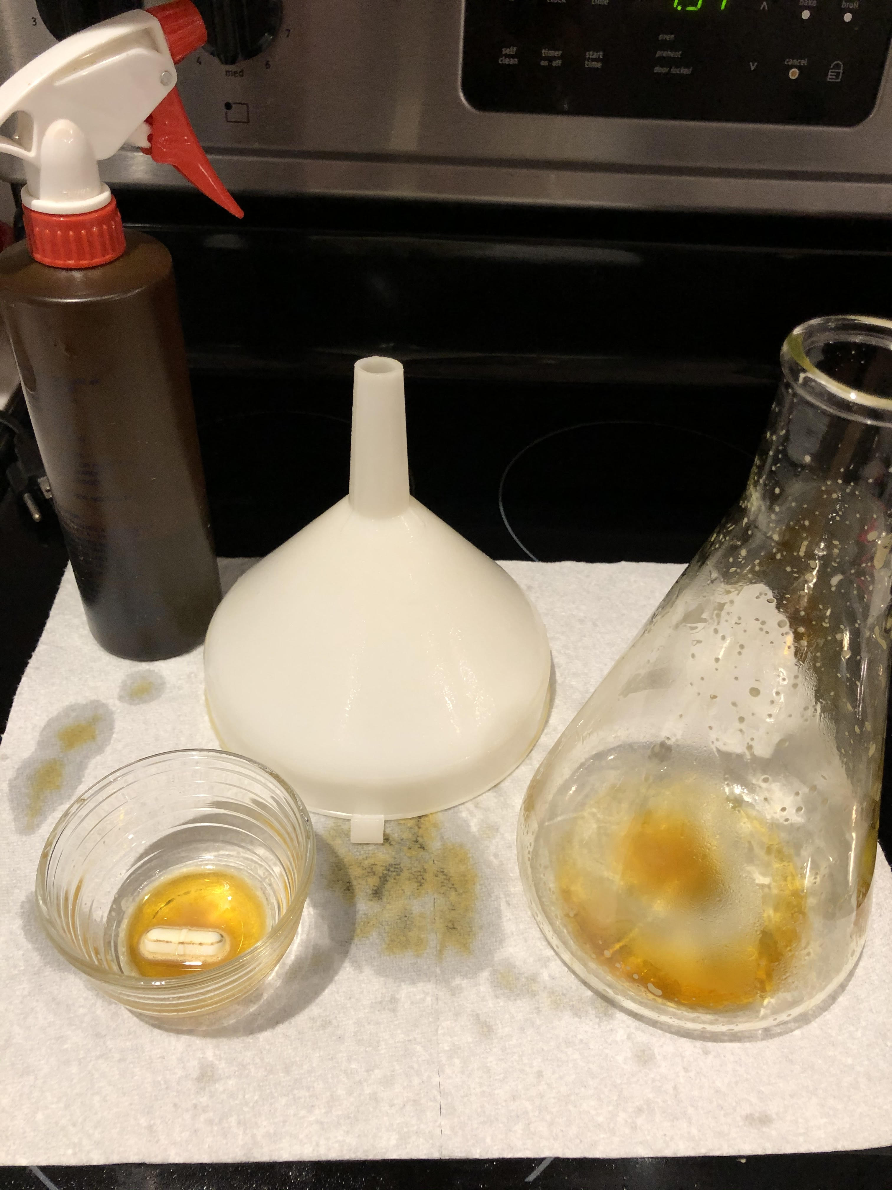
Yeast Starter – Prep
As the wort is boiling:
Prepare for the boil to end by ensuring flask, funnel, and magnetic stick are sanitized

Slide 9
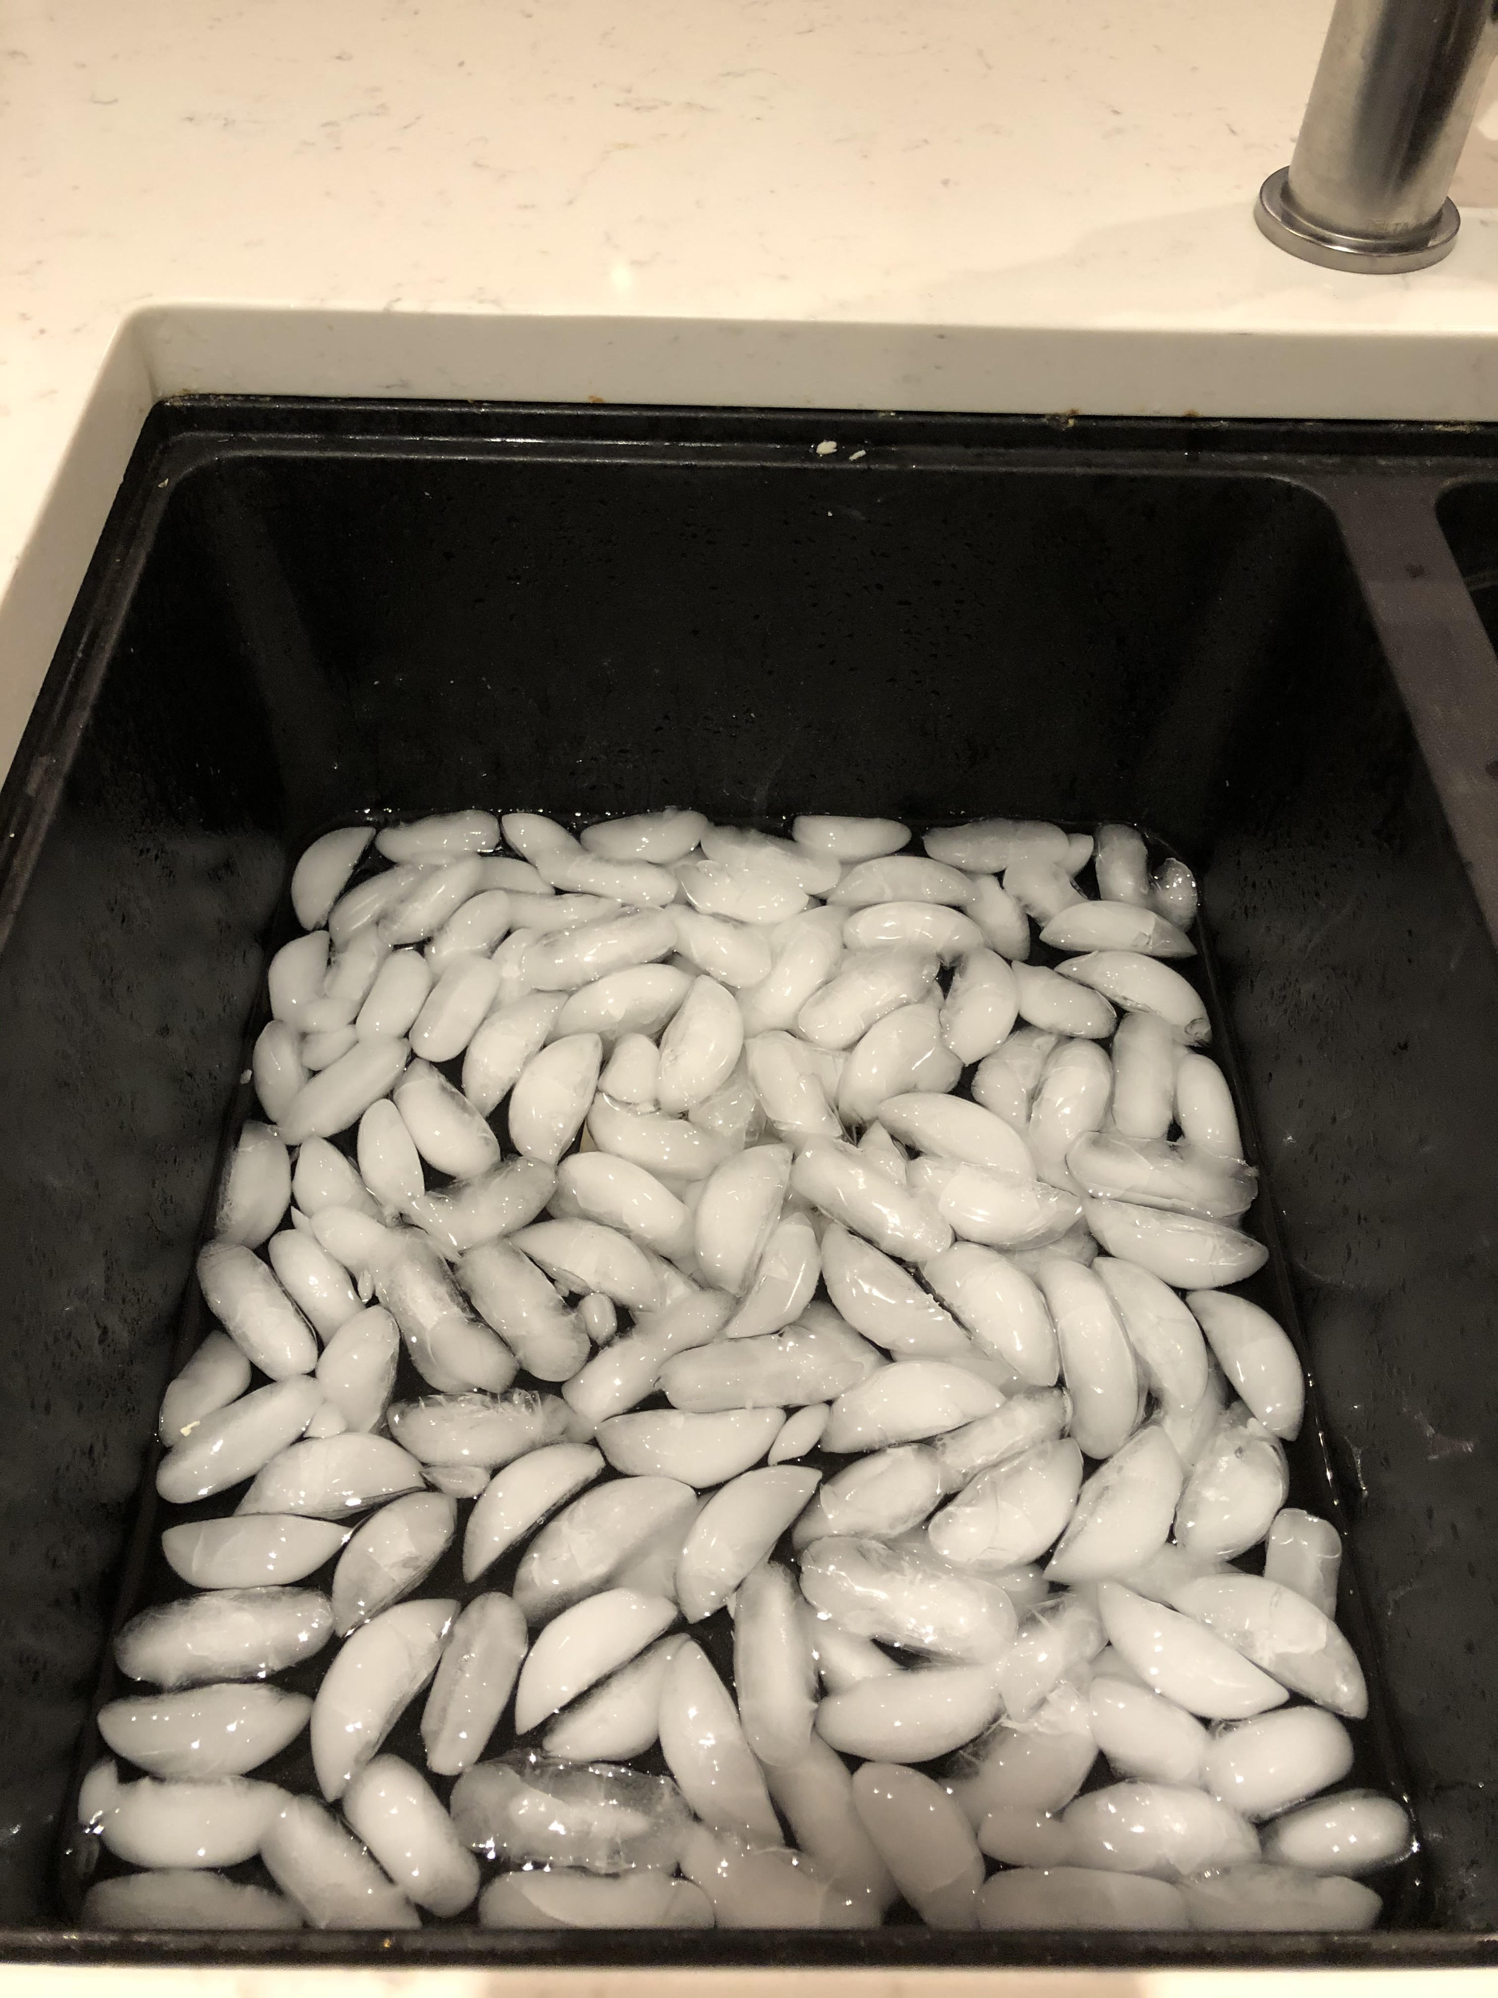
Yeast Starter – Prep
You will need to get an ice bath ready to chill the wort

Slide 10
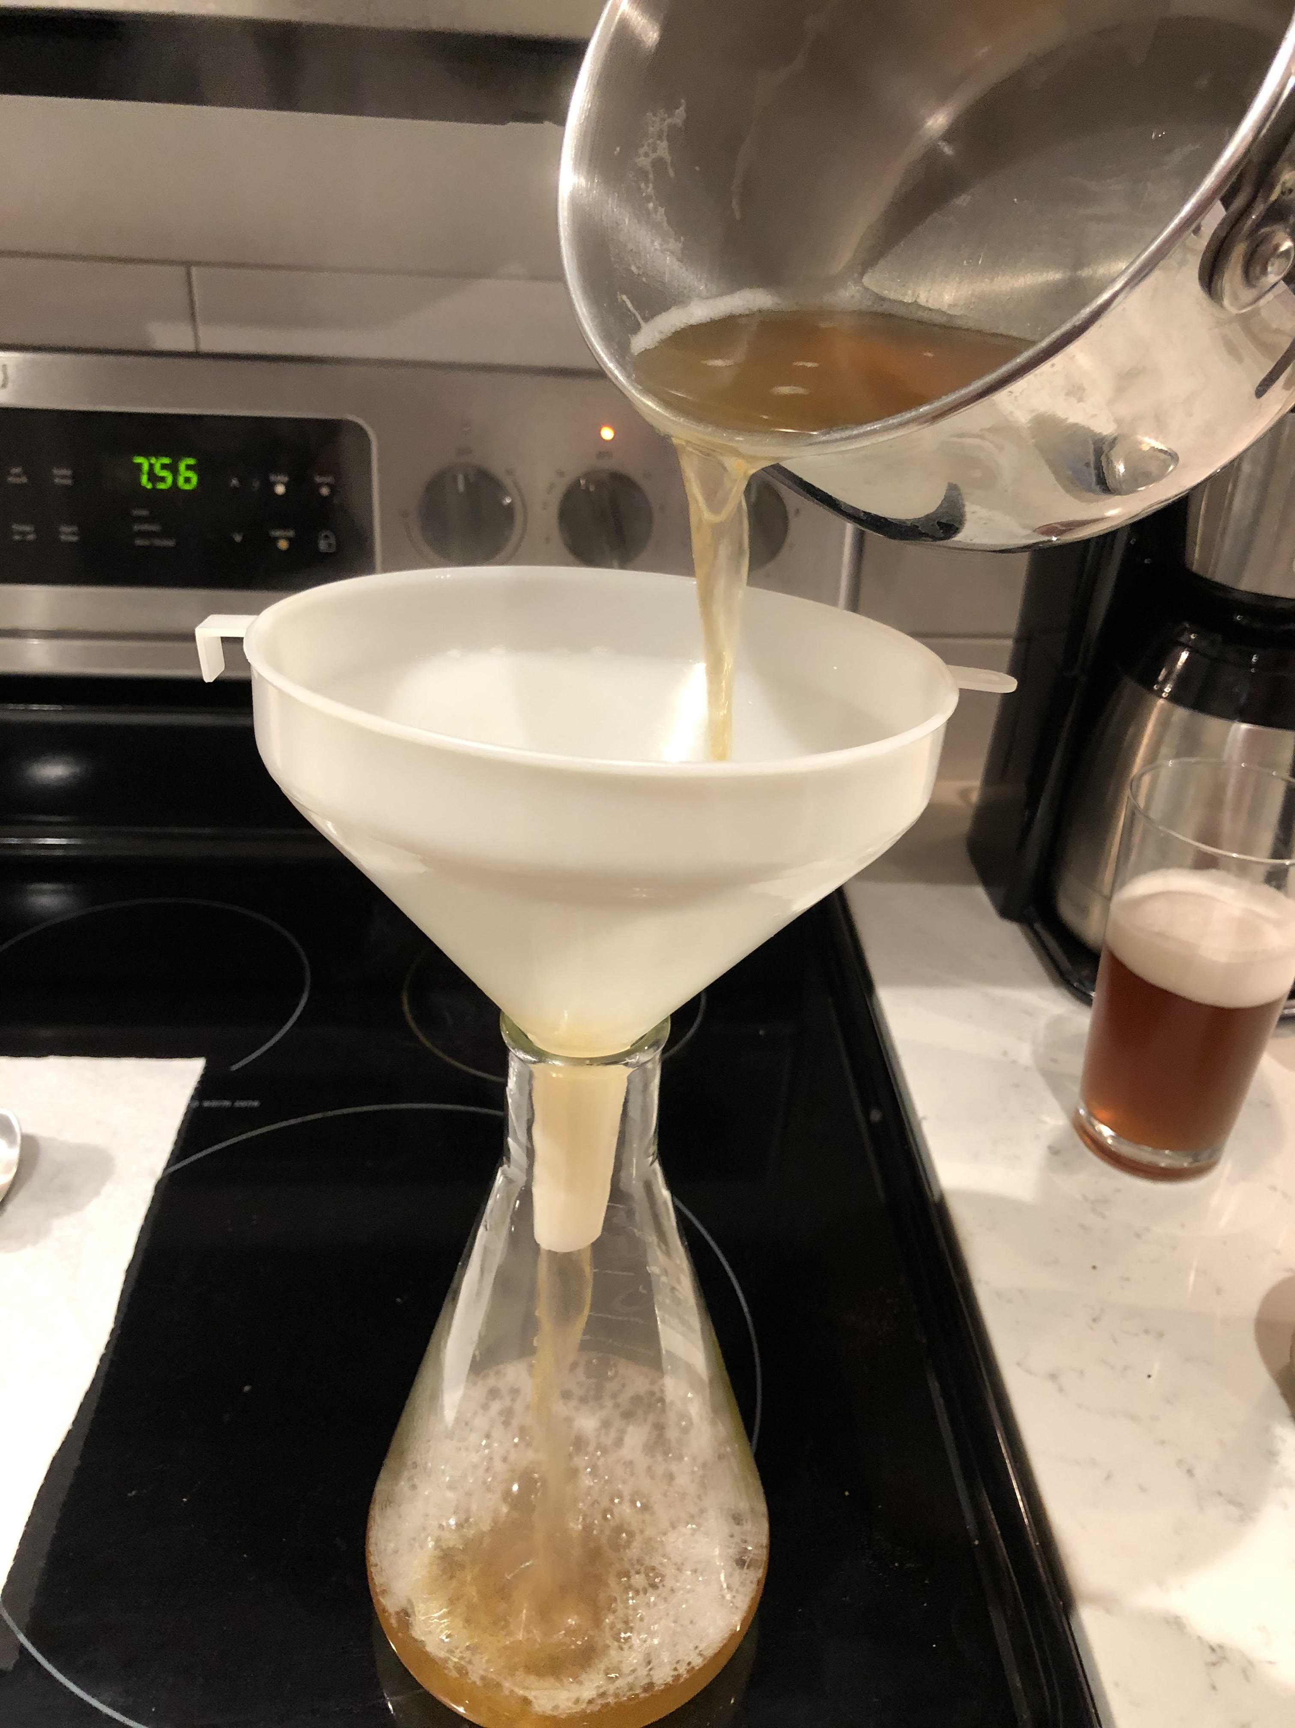
Yeast Starter – Step 4
Once 10 minutes are up, carefully transfer wort to flask.

Slide 11
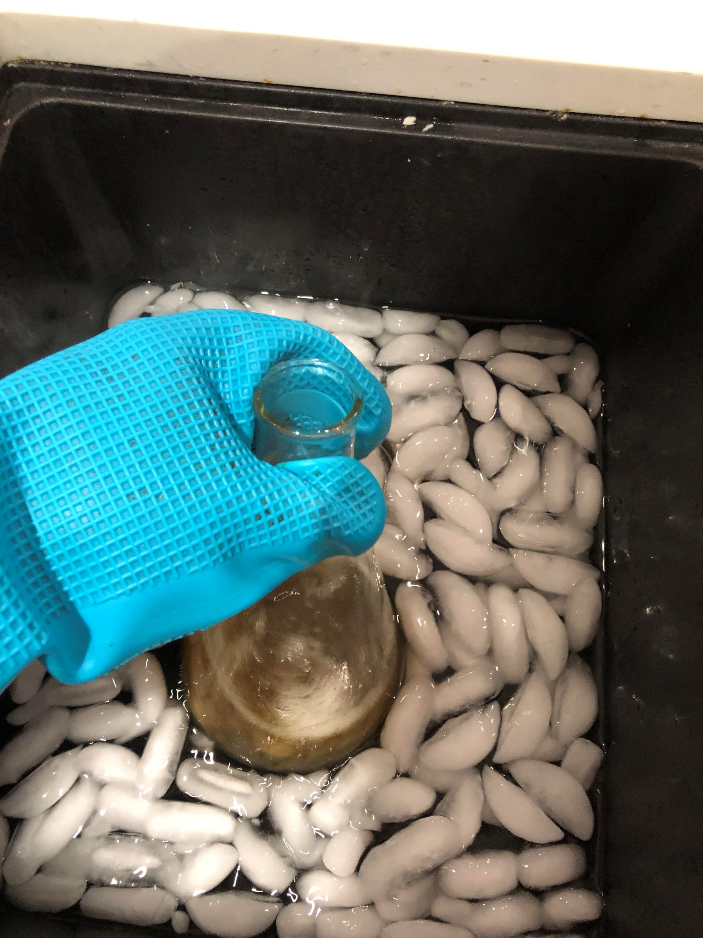
Yeast Starter – Step 5
Cool wort down to room temp.
Ensure you use an oven mitt or some safety protection – this is HOT!
Don’t need a thermometer, feel the flask – takes about 7 min to cool.

Slide 12
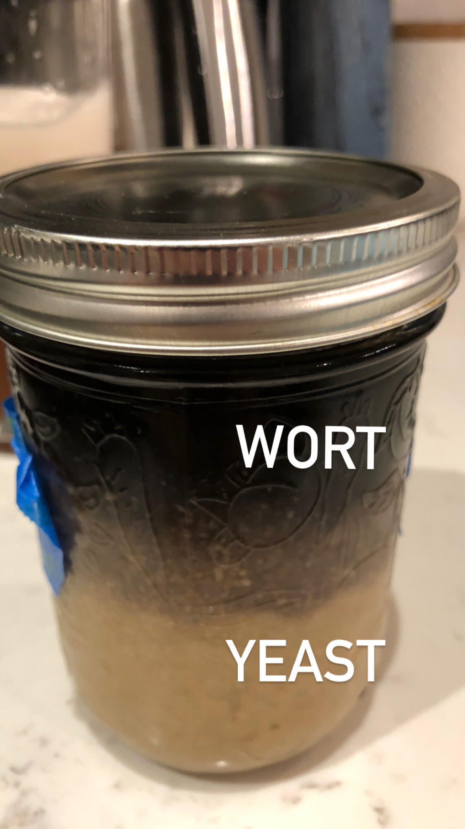
Yeast Starter – Step 5
NOTE: Within my saved yeast, the yeast settles, and the “old beer” rises to the top.
Can shake to make a solution OR can dump out the top wort and use JUST slurry

Slide 13
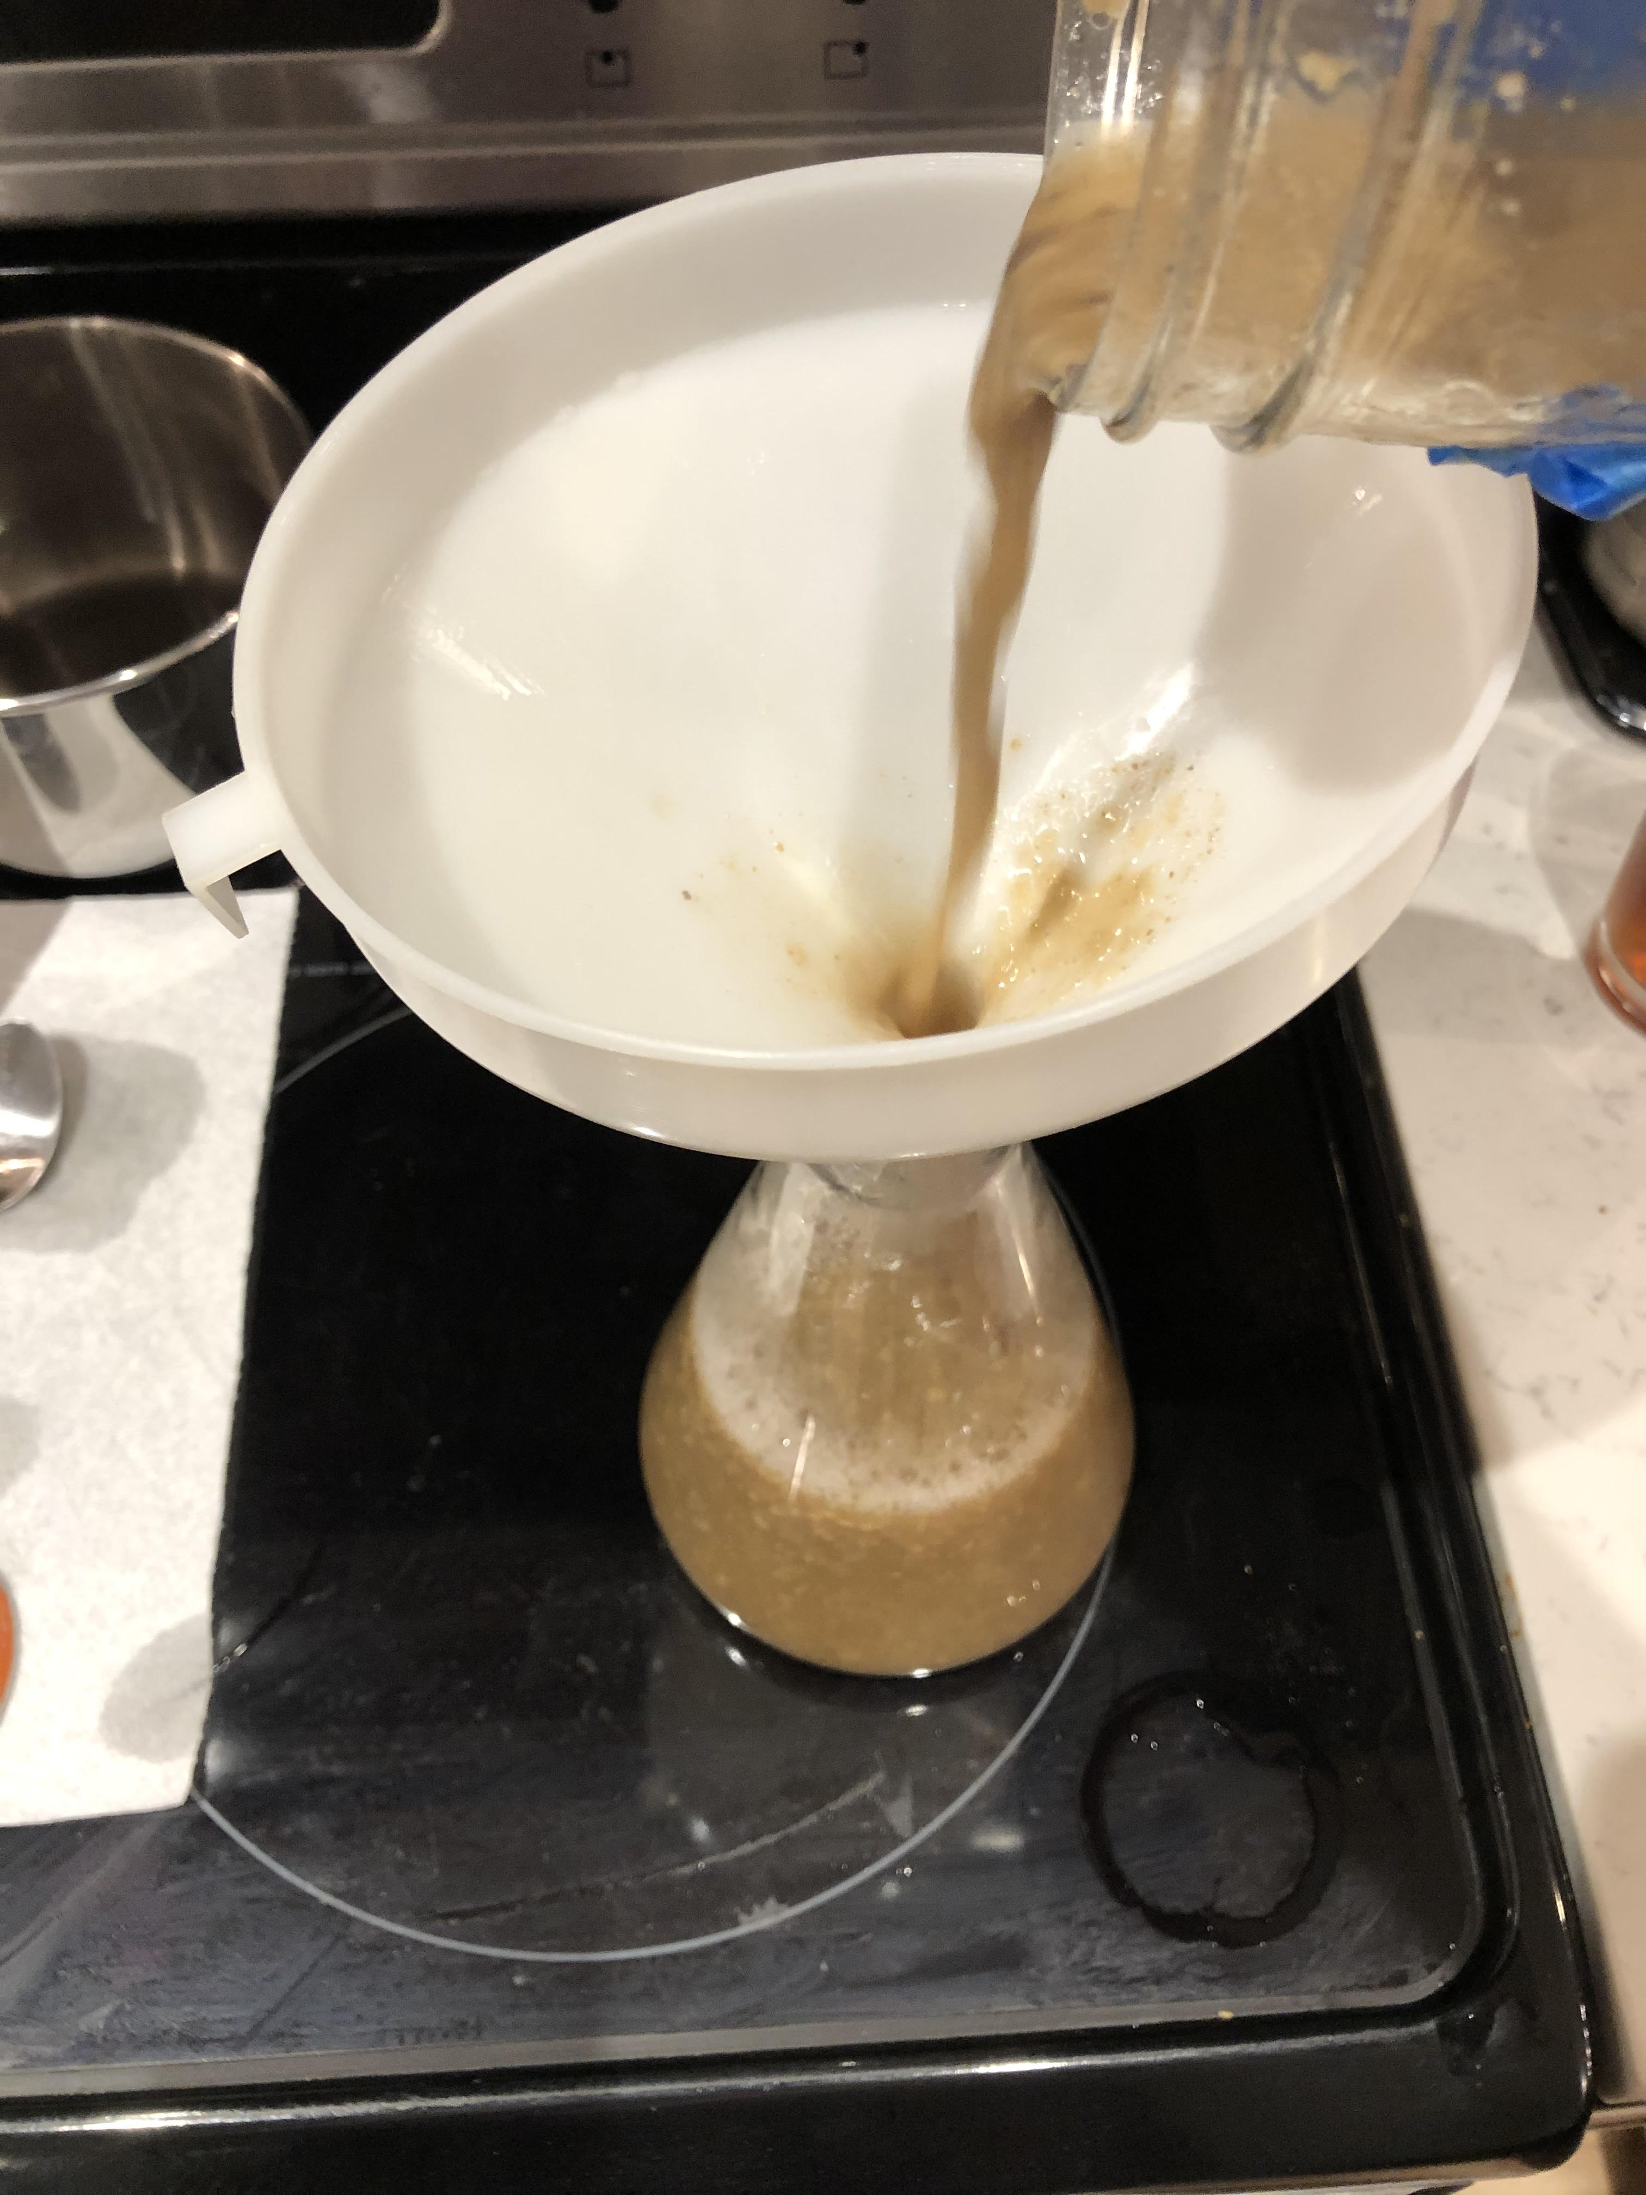
Yeast Starter – Step 6
Once wort cooled, transfer yeast slurry to the flask

Slide 14
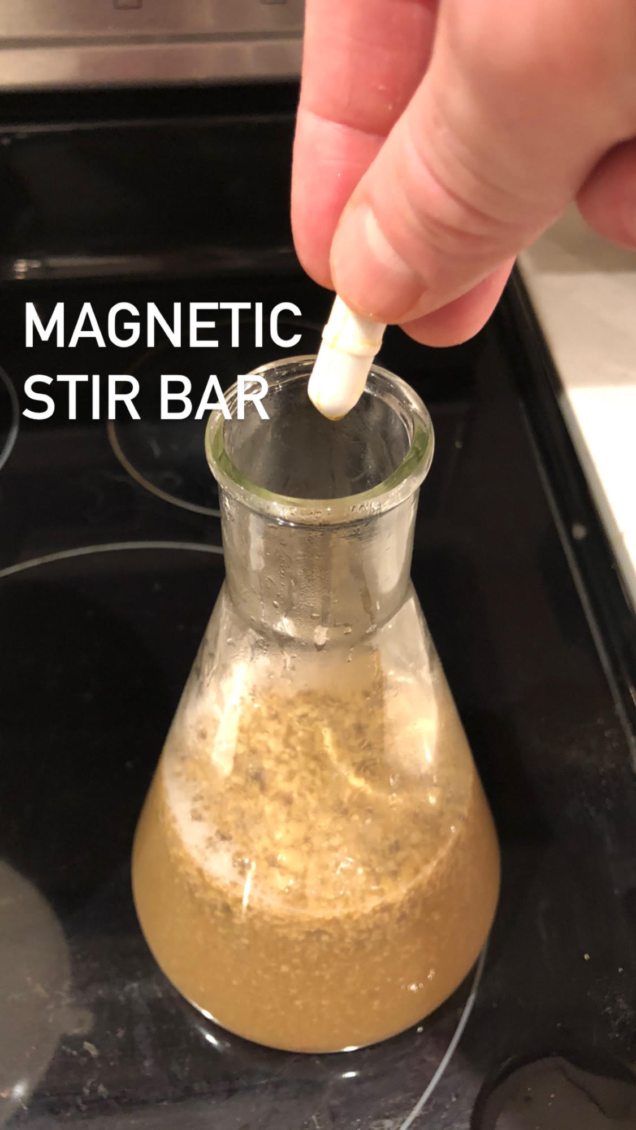
Yeast Starter – Step 6
Ensure you add the magnetic stir bar to the flask

Slide 15
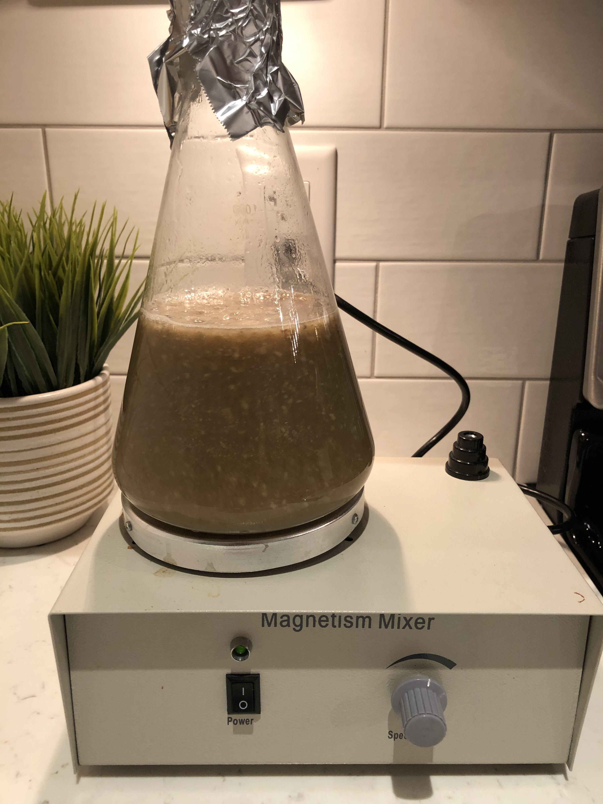
Yeast Starter – Step 7
Add sanitized tinfoil to top of flask and place on the stir plate for 24 hours.
No need for airlock; you want oxygen exchange between liquid and air so all you need is a loose-fitting aluminum foil

Slide 16
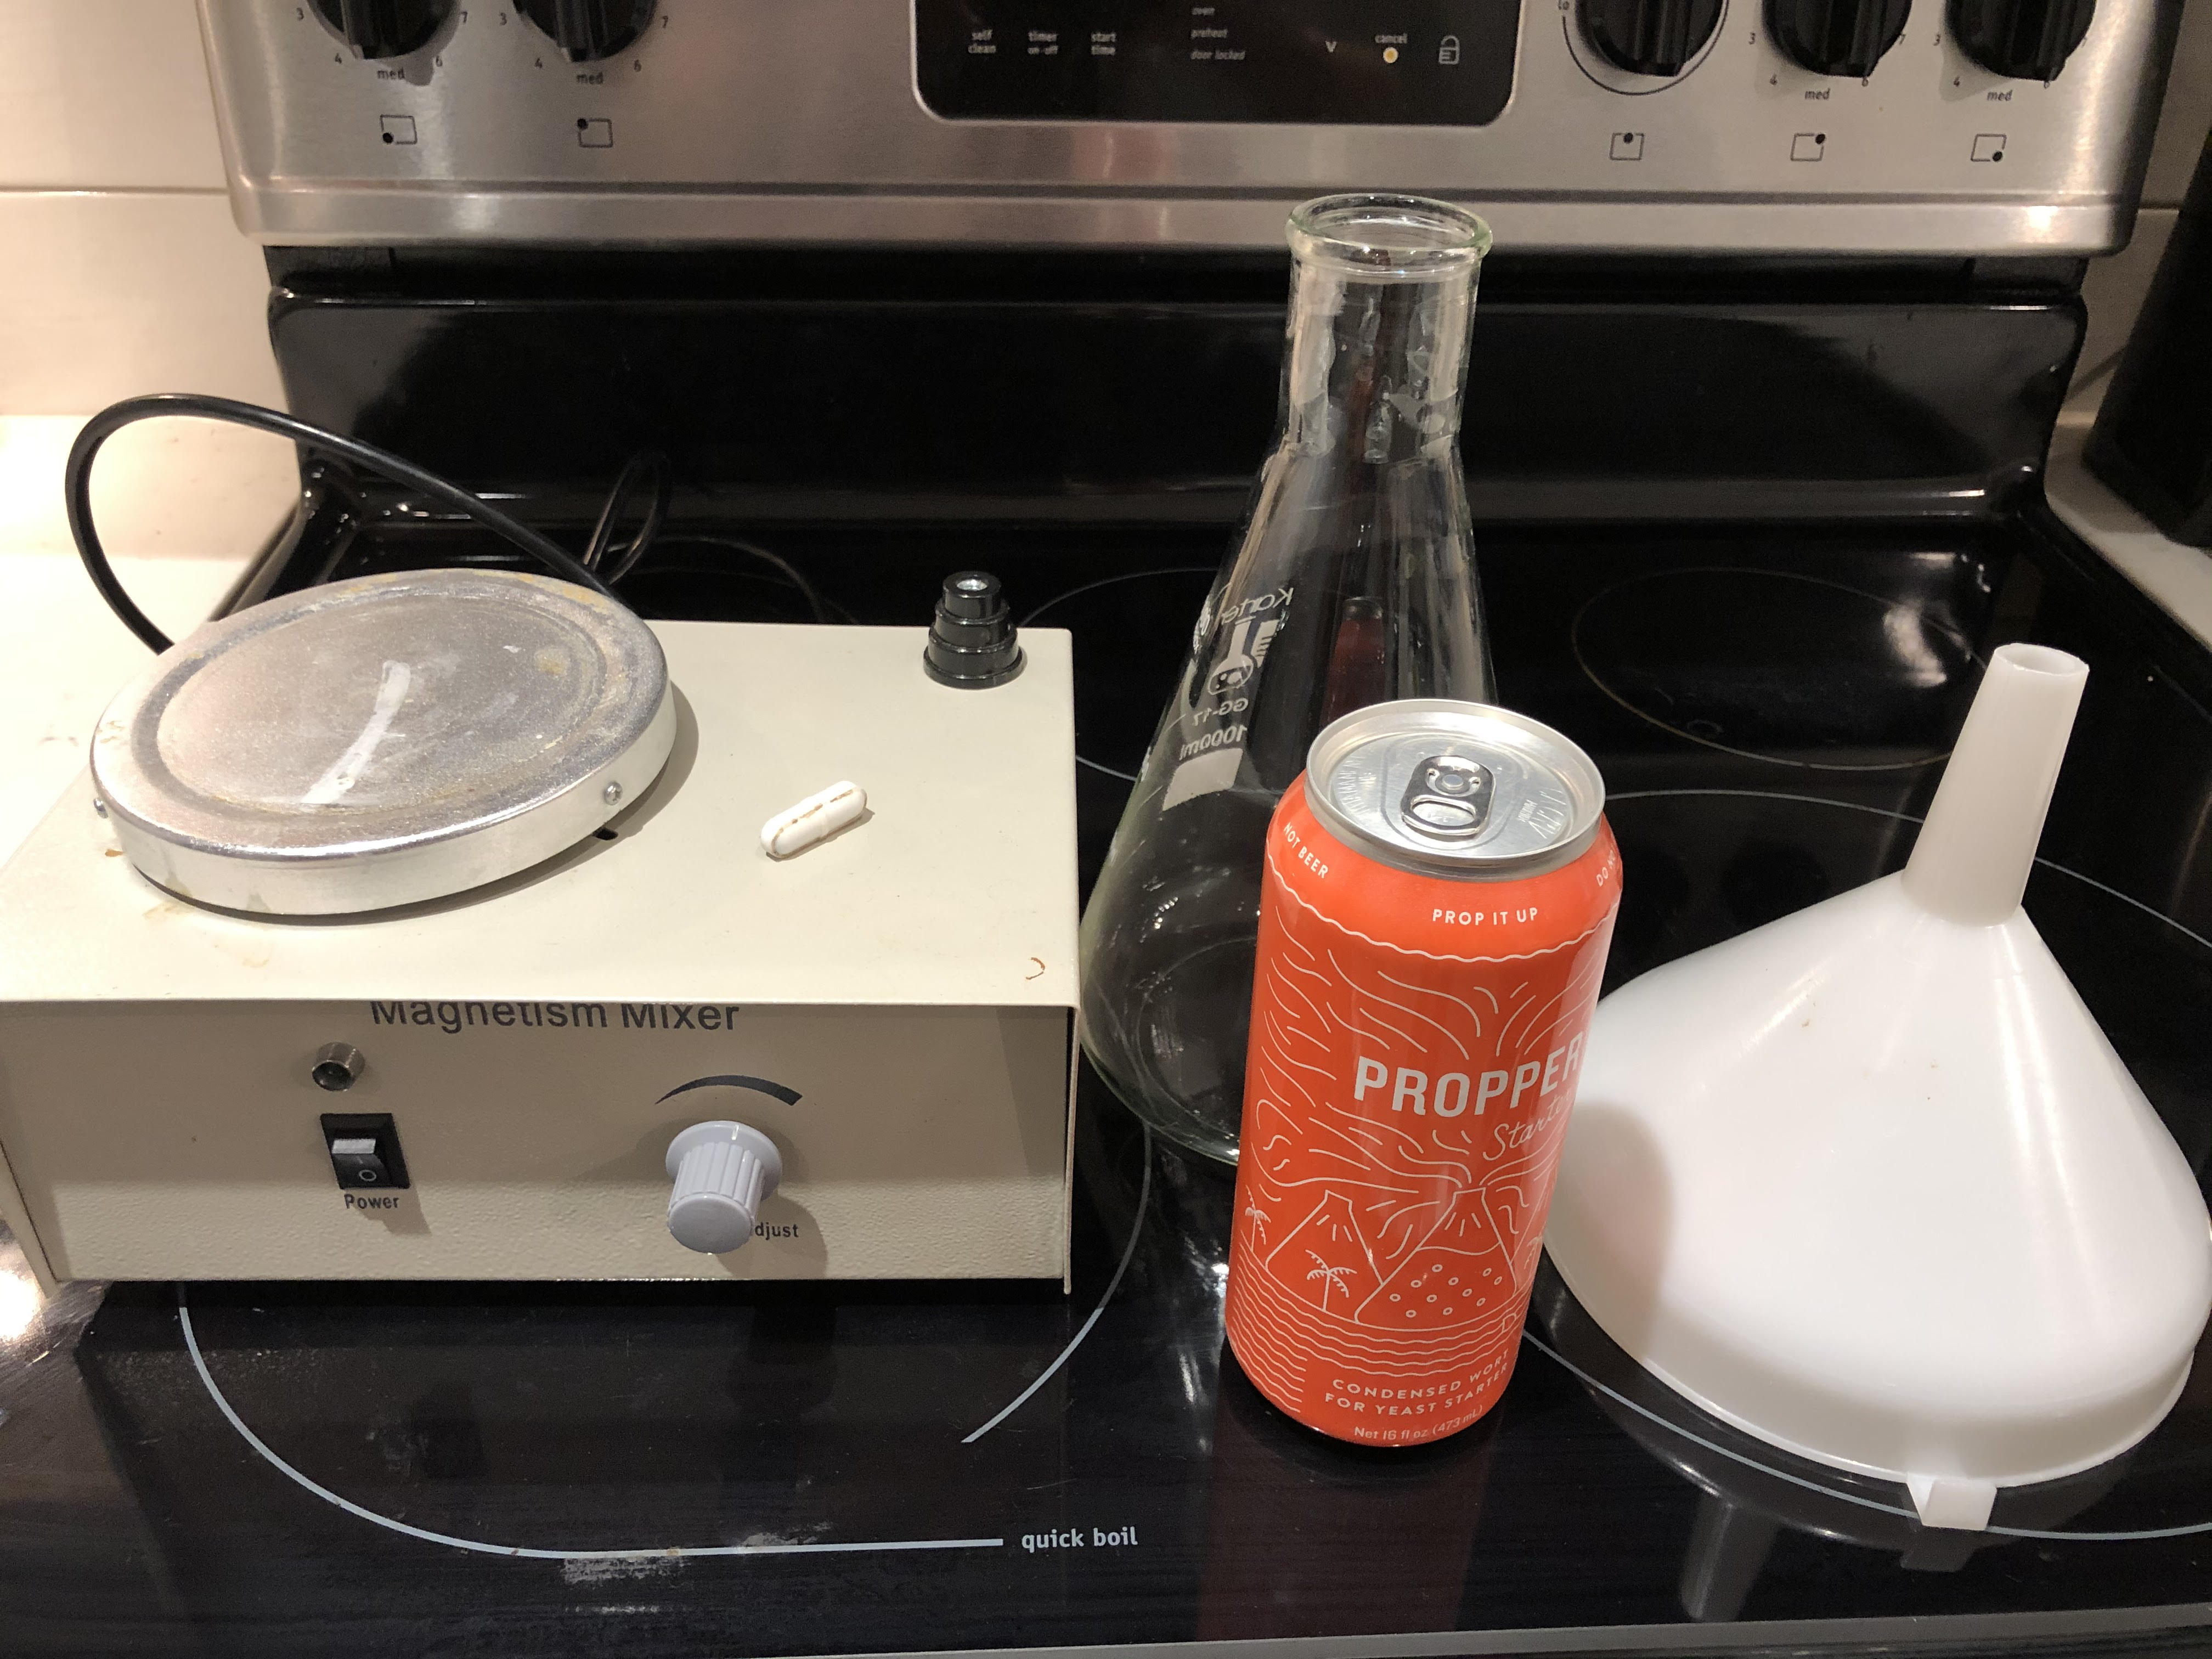
Yeast Starter – The Easy Way

Slide 17
Conclusion
Total time to create a wort starter is roughly 20 minutes.
A ½ cup of DME is cheap; 1 lb of DME will go a long way
Yeast starters can resurrect yeast in the back of your fridge
If you have too few yeast cells in a wort, they need to work very hard and could create off flavors in your beer
Questions?

